Slide 1
SECURITY
ABDUL RAHEEM RIHAM AHAMED

Slide 2
Table of Content
Introduction to security
Identification of assets & prioritization
Risk & Threat Analysis
Threats to assets
Physical Security Solutions
Virtual Security Solutions
Limiting number of vendors
Advanced security measures
Security Policy
Ensuring sensitive assets interact with trusted networks
Referance

Slide 3
Introduction to security
The simple means of protecting and taking measures to protect something that has a value from any unit or degree of potential kind that could either take the valuable substance or make it lose it’s value, is the ideology of security.
For this scope however, the valuable will be information and technology to combat the threats the information is exposed to.
Ascom as a financial industry must primarily concentrate in cut-end technologies that does not sacrifice efficiency & performance for the sake of security.

Slide 4
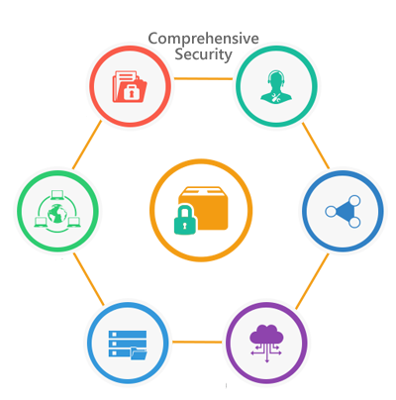

Security in IT can be broadly categorized into Physical and Virtual security.
While the former focuses on protecting and ensuring the physical availability and functionality of the systems involved, the latter is based on everything from organizing access levels to ensuring data corruption doesn’t take place.
Before all else, asset identification and prioritization must take place. This will allow us to effectively determine which type of security will suit the task.

Slide 5
Identification of assets & prioritization
The primary and irreplaceable asset Ascom must protect at all cost are, transactions, ensuring transactions happen between the involved parties and anonymity.
An asset is any particular object or piece of information that in the wrong hands may cause problems to the organization. Anything from employee data to monthly transaction density.
Aside from assets, resources like manpower is important to take into count.
Securing assets is important but, it is always very crucial to ensure that securing any asset or resource does not hinder effective functionality.
The degree and method of protection for an asset depends on how irreplaceable it is to Ascom. With low-scale payment details taking the lowest, to long-term investment and financial transaction details of large amounts being the highest.

Slide 6
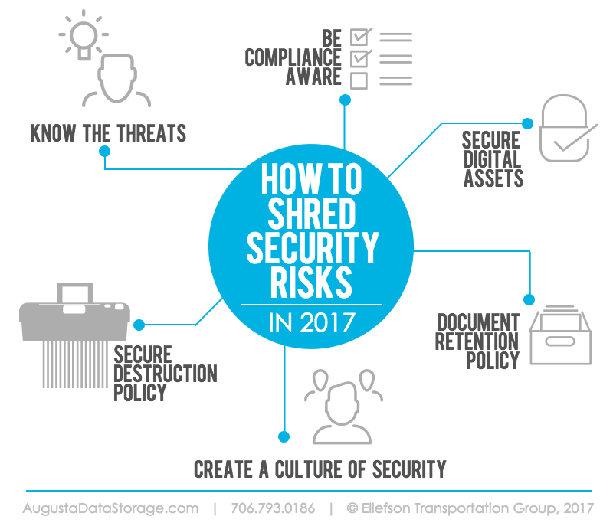
Risk & Threat Analysis
Notes:
Knowing what threats your assets are exposed to, is very important, so you have an idea of how to protect them.
Stay alert and being aware on the status of your digital and tangible assets, regular backups and proper storage systems is therefore important.
When getting rid of an asset unless the information they contain can not harm the organization in anyway, they must be disposed of appropriately.
If physical documents are being disposed, they must be sent through paper shredders.
If it is a virtual asset being disposed, it must be deleted from memory and ensured that there is no trace of them or restore points available to regain the removed asset.
Spread your knowledge of how and what it means to secure your company’s assets so that everyone knows what to protect and how to protect.

Slide 7
Threats to assets
As long as an asset has a monetary value, it is exposed to a risk and therefore it is fully possible for an asset to be affected by a threat.
As Ascom is company full of valuable assets in every crook and cranny, the threats to the assets of the company must be properly understood.
Data Corruption – The information in storage systems may undergo corruption due to some mutation in the system or an external factor.
Machine failure – Systems involved in maintaining workflow and/or security devices breaking down.
Theft – Physically or virtually obtaining information through unauthorized access
Employee distrust – May lead to information being sold by employees within the firm to external bases
Usage of obsolete systems - Security devices specially, if outdated or no long supported by the vendor must not be used.

Slide 8
Physical Security Solutions
All terminals connected to the network must be in well air-conditioned and dust free environment s
Server machines must be specifically maintained and regularly checked on using surveillance cameras to monitor their status.
Access hierarchies must be implemented with care, security guards must be placed in strategic locations such as information storage facilities, server rooms, information disposing counters etc. so that only those of that particular access-level may enter
Door locks or card-based access systems must be employed in order to further access hierarchies.
Regular maintenance and backup schedules must be seen to, and the backups must be stored in encrypted formats if virtual and in locked drawers if physical.
Notes:
Refrain from sharing important and sensitive information about the organization’s assets or their value with comrades out of the business.
While in working environment, keep edibles and beverages away from electronic devices or documents that may get damaged.
Count in the rigidity and the flexibility in furniture and storage appliances used to store sensiitive information.
Rooms bound by high access levels are best to be locked-tight with no windows or ventillation methods, so that there is only one entrance and one exit.

Slide 9
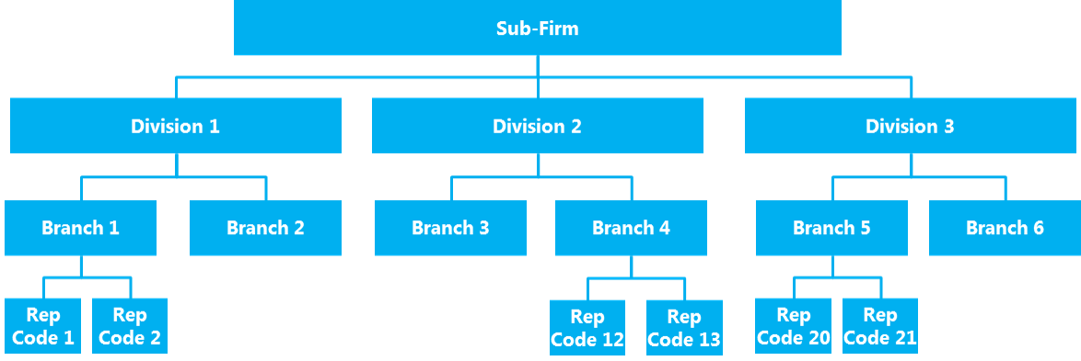
Notes:
Each sub-firm or department must be categorized into divisions, with division heads given access rights that allow them to modify or limit those of his/her division.
Each branch must have access rights that allow them to access or retrieve information only but can be fllexibly modified depending on department the branch is categorized under.
Example case scenario, customer service department will categorize into divisions based on what type of support they provide, division heads will have rights to employ or restrict the access exposure of lower members and each branch of the division will focus on retrieving information and only modify information under the permission of a division member, who would consult the division head for permission in turn.
All departments must have a department head, all department heads must be directly employed under a manager.

Slide 10
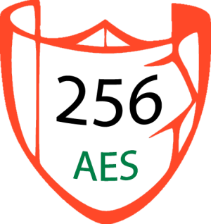
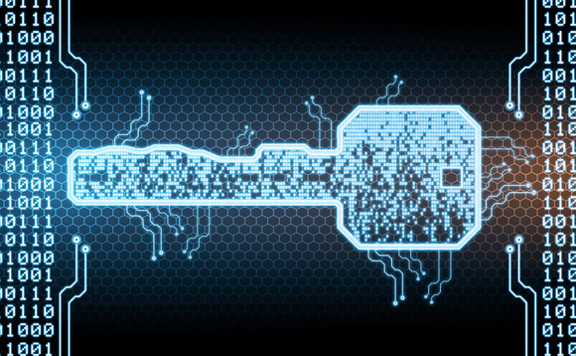
Virtual Security Solutions
American Encryption Standard of the 256-bit variety must be used on any and all stored transaction details.
Users of Ascom’s internet based portals must be provided with options like; 2-factor authentication and mobile phone account recovery and alerting.
The websites must be SSL certified running under a trusted HTTPS domain provider with cut-end as less as possible downtime hosting providers like Fastcomet or Bluehost.

Slide 11
Webpages must be developed in ways that cross-site scripting is impossible.
Firewalls must be installed to the network, and configured with highest security-best performance settings.
Layer 3 routers must be employed and VLANs must isolate departments that require the privacy of acting from the rest.
Regular maintenance is highly necessary, the IT staff whenever possible must attempt to search for loopholes in security and patch them then update in order to remove loopholes.
Email scanning software must be distributed to every terminal in the network, with settings enabling automatic scanning BEFORE opening emails.
Usage of Demilitarized zone techniques when troubleshooting or searching for loopholes is necessary but while ensuring ports like 80 & 8080 are monitored is well necessary

Slide 12
Limiting number of vendors
Vendors are those who provide Ascom with particular services that are required in order to cater to needs.
Usually companies use a vast number of vendors without fully understanding that, each vendor’s service comes with it’s own set of problems, bugs, errors etc. that can be exploited, which combined with lots of others exposes the entire company.
As such, carefully identifying and choosing good vendors that provide a large number of functions with the highest security is ideal.
Ascom as a finance company can function without any issue if it employed only a maximum of 17 different security vendors that will specifically target every asset and secure it.
Limiting the number of security vendors is also profitable, easier to maintain and effective in the long run.

Slide 13
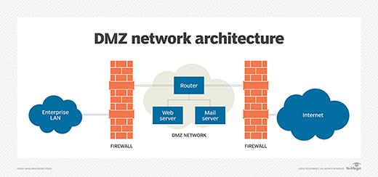
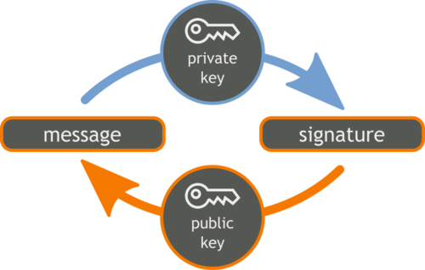
Advanced security measures
Passing traffic through firewalls when accessing untrusted networks like the internet.
Using digital signatures to grant access to sensitive vaults of information and storage.
Usage of static IP addresses so that services can be hosted while stability is ensured, and more importantly the static ip can be tracked to monitor access at any given time.
Employ Network Address Translation which allows the hiding of source and destination addresses while also ensuring ipV4 addresses are never depleted within the network. This will allow for extra flexibility when connecting to the internet.

Slide 14
Security Policy
A security policy is a strategically broken down set of rules, penalties, instructions and so on such that the company does not exceed unnecessary boundaries and pointlessly expose the assets of the company to risk.
Ascom must employ a security policy from ground up highly focusing on transactions to do with money, departments like the accountants and technical operators and access hierarchies.
Necessary training must be provided for each and every employee of Ascom after the security policy has been designed and reviewed.
Whenever a rule, instruction or statement declared in the security policy is not followed, a penalty for it must be taken.
Ensuring that the security policy does not reach external audiences is crucial. As this is the heart of the security of the company.

Slide 15
Ensuring sensitive assets interact with trusted networks
This means that within Ascom any system responsible for transaction details or financial connections that is associated with money will become a part of a trusted network with a strictly described rule set and will not be granted access to the untrusted networks such as the internet.
This will shut off any possibility for attacks to come from external untrusted levels.
However this trusted network can interact with other trusted networks as long as they do not have any connections with untrusted networks.
Firewalls must be implemented, preferably manageable switches with the ability of VLAN creation must be used and a router must be employed for inter-VLAN communication within the trusted network.
This will greatly boost the security of the trusted network and therefore the assets protected within it.
When information has to passed on to untrusted destinations, employ a Virtual Private Network.
Notes:
A trusted network is the one which is under the control of the network manager or the network administrator.
Basically, this is the network that a network admin tries to protect and defines the security parameters for the same. So, it can also be said that the trusted networks are within the security perimeter.
In the context of VoIP and IP networking, trusted and untrusted zones are defined by where the security control devices are located. Firewalls are typically used as an IP network control point and SBCs are used as VoIP control points.
It is important to place an SBC between trusted and untrusted IP networks to provide security policies and ensure that each network does not have a direct connection. The Internet is the most untrusted IP network, and carrier private WAN IP networks are also outside the security of the enterprise trusted LAN network.

Slide 16
Reference
Anon., 2016. Techo Pedia. [Online] Available at: https://www.techopedia.com/definition/16522/risk-analysis [Accessed 19 February 2021].
Anon., 2021. Instiute of Forensics and ICT Security. [Online] Available at: https://www.forensicsinstitute.org/what-does-software-security-mean/ [Accessed 19 February 2021].
Anon., 2021. Threat Analysis Group. [Online] Available at: https://www.threatanalysis.com/2010/05/03/threat-vulnerability-risk-commonly-mixed-up-terms/ [Accessed 19 February 2021].
Contributor, T., January 2017. TechTarget. [Online] Available at: https://searchsecurity.techtarget.com/definition/security#:~:text=Security%2C%20in%20information%20technology%20(IT,software%20tools%20and%20IT%20services. [Accessed 19 February 2021].

